Slide 1
Unsupervised Learning

Slide 2
Unsupervised learning is conceptually different from supervised learning
The aim of classification: to identify similarities between inputs that belong to the same class;
The aim of unsupervised learning: to find clusters of similar inputs in the data without being explicitly told that these data points belong to one class and those to a different class.
The supervised learning algorithms aimed to minimize some external error criterion (e.g., SSE) based on the difference between the targets and the outputs.
The unsupervised learning (i.e., clustering) aims to minimize the distances between data points in the same clusters, while maximizing the distances between data points in different clusters

Slide 3
K-means clustering (MacQueen 1967)
Learning a partition on a data set to produce K non-empty clusters (K: the given number of clusters)
The optimal partition is achieved by minimizing the Sum-of-Squared Errors (SSE) to its “center” in each cluster
e.g., Euclidean distance
Each cluster is represented by the center of the cluster and the algorithm converges to stable of clusters.

Slide 4
K-means (Lloyd’s) Algorithm
Given the cluster number K, the K-means algorithm is carried out in three steps after initialization:
Initialization: set random data points as centers
Assign each object to the cluster of the nearest center measured with a distance metric (i.e., the partition)
Compute new centers of the clusters based on the current partition (the center is the gravity center of the data points in the same cluster)
Iterative between 1) and 2) until the partition does not change.
The algorithm always converge, as in each step of iteration, the SSE always decrease. However, it may not give the optimal partition (with the minimum SSE). In practice, one may start from multiple initiation and select the final partition with the minimum SSE.

Slide 5
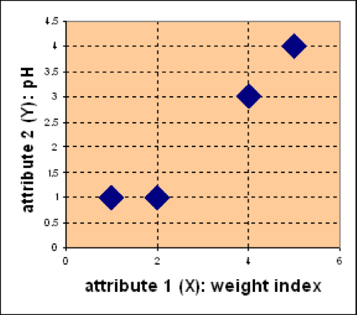
Example
Problem
Suppose we have 4 types of medicines and each has two attributes (pH and
weight index). Our goal is to group these objects into K=2 group of medicine.
D
Medicine | Weight | pH-Index
A | 1 | 1
B | 2 | 1
C | 4 | 3
D | 5 | 4
C
A
B

Slide 6
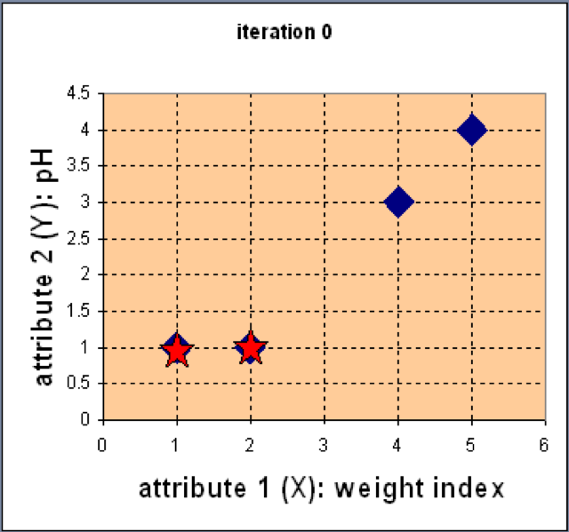
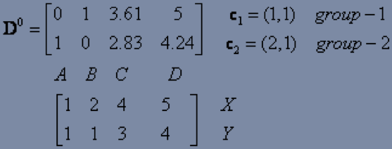
Example
Step 1: Use initial centers for partitioning
D
C
Euclidean distance
A
B
Assign each object to the cluster
with the nearest center

Slide 7
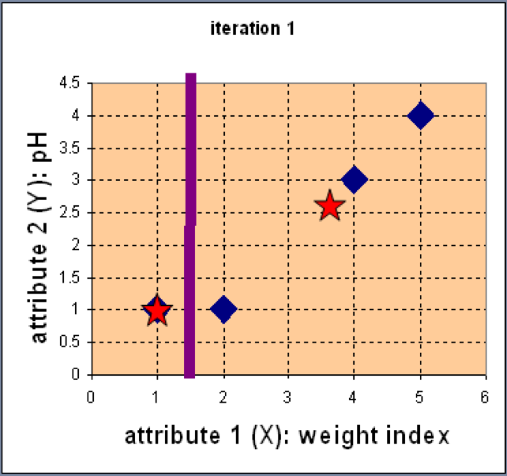
Example
Step 2: Compute new center of the current partition
Knowing the members of each
cluster, now we compute the new
center of each group based on
these new partitions.

Slide 8
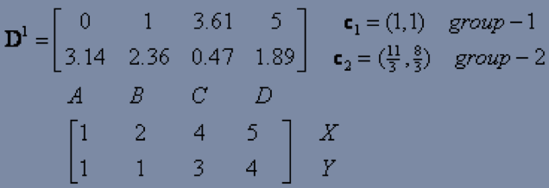
Example
Step 2: Renew assignments based on new centers
Compute the distance of all data points to the new centers
Assign data points

Slide 9
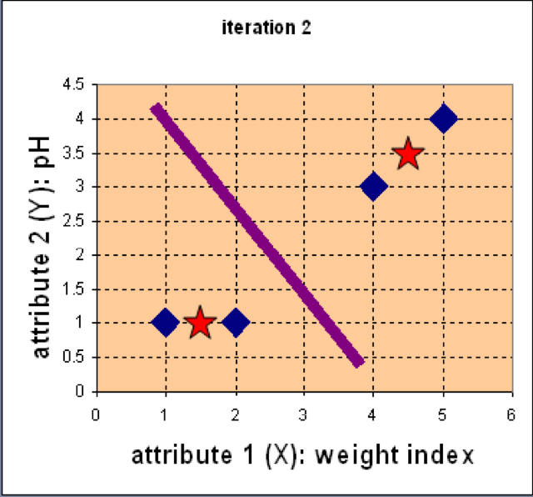
Example
Step 3: Repeat the first two steps until its convergence
Knowing the members of each
cluster, now we compute the new
center of each cluster based on
these new assignments.

Slide 10
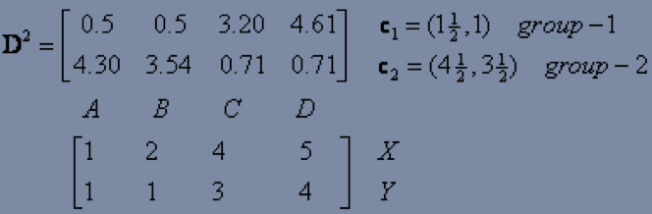
Example
Step 3: Repeat the first two steps until its convergence
Compute the distance of all data points to the new centers
Stop due to no new assignment, the membership of each cluster does not change

Slide 11
Practical issues
Selection of K: By running the algorithm with lots of different values of k, we can see which values give us the best solution.
If we still just measure the SSE, then when we set k to be equal to the number of data points, we can position one center on every data point, and the SSE will be zero (overfitting).
Can be compensated by computing the SSE on a validation set and multiplying the error by K.
Dealing with noise: the mean average is very susceptible to outliers, i.e., very noisy measurements.
replace the mean average with the median, which is known as a robust statistic, meaning that it is not affected by outliers.

Slide 12
The k-Means Neural Network
A single-layer neural network can implement the k-means solution.
Linear transfer function:
Prediction: choose the neuron with the highest activation h to be the center to which an input data point is assigned (winner-takes-all)
The inputs are normalized so that their absolute size is the same → the weight vector is normalized
Training: one input vector at a time; update by moving the winning neuron closer to the current input
inputs
K centers

Slide 14
Self-Organizing Feature Map (SOM; Kohonen 1998)
A grid of neurons arranged in 2D
Input nodes (left) do no computation, and the weights are modified to change the activations of the neurons. However, the nodes within the SOM affect each other in that the winning node also changes the weights of adjacent neurons
SOM demonstrates topology preservation: neurons close together represent inputs that are close together, while neurons that are far apart represent inputs that are far apart.
Feature mapping

Slide 16
Changes of Neighborhood Connections

Slide 17
Selecting SOM
The boundaries of the network is pre-defined
or removed
The size of the network (i.e., the number of neurons that we put into it) is pre-defined, which decides how fine-grained the learning is.
If there are very few neurons, then the best that the network can do is to find gross generalizations that link the data.
If there are very large numbers of neurons, then the network can represent every input without ever needing to generalize at all (i.e., overfitting). Choosing the correct size of network is important.
The common approach is to test out several different sizes of network, such as 5*5 and 10*10 and see how well the network learns.

